Slide 1
Radiology Protocol Tool & Reporter (RAPTOR) Milestone #2 Review
SAN Business Consultants
March 23, 2014

Slide 2
Milestone #2 Agenda
Overview – Definition and Approach
Milestone #1 Review
Changes in the Innovations Sandbox
Series of SME meetings
User Acceptance Testing prep
Risk Log
Questions & Demo

Slide 3
Project Definition
Improve the safety, quality and efficiency of the protocol workflow
Evolve the prototype into the RAPTOR application in 15 months
Visual Design & Theme
Technical Implementation
Testing and Launch

Slide 4
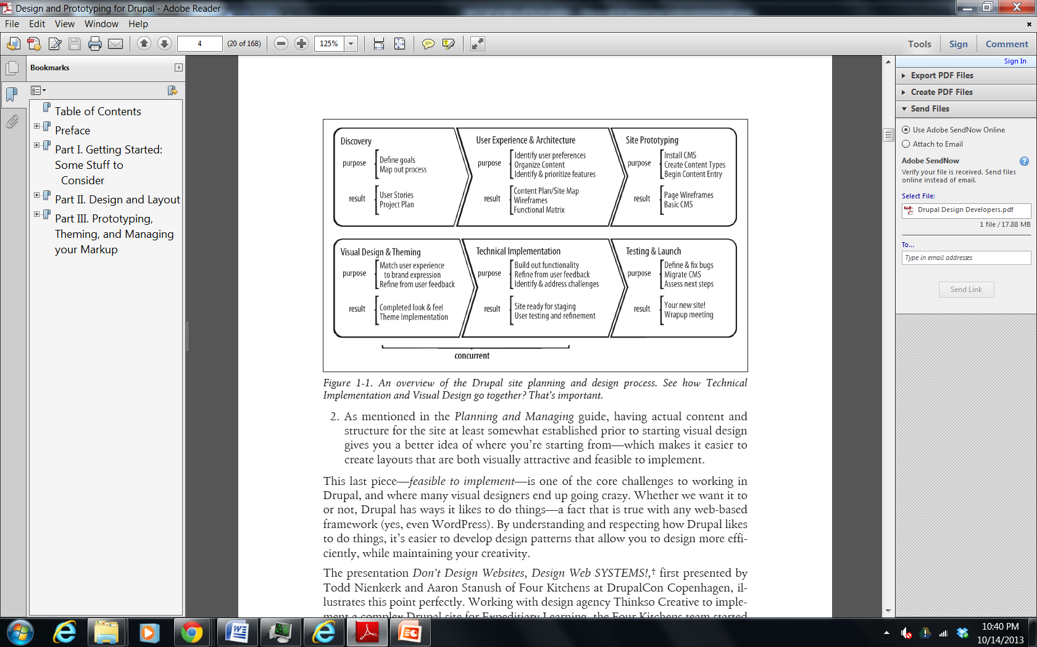
Approach of project
From Designing and Prototyping in Drupal, D. Nordin, 2012

Slide 5
Milestone #1: Dec 23,2013
Increment #1 submitted on time included:
Style Sheets and theme images of new worklist and prototype screens
Contraindication Engine Architecture
Worklist Item Ranking
Worklist Processing Modes
Site Map
UI Guide
Ranking Algorithm
PM Plan, v.1.2

Slide 6
Innovations Sandbox
SAN created and populated advanced imaging test data and installed the data loader into the sandbox
Migrated from cloud1 (VMware view client) to cloud2 (Amazon)
31 tickets total, open issue on VIX code
SAN will need to install VistA Imaging
SAN will need to create imaging test database

Slide 7
SME meetings
We have held a series of functional meetings
Requirements gathering
Account Creation for UAT preparation
Challenge in keeping project scope contained resulted in enhancement opportunity

Slide 8
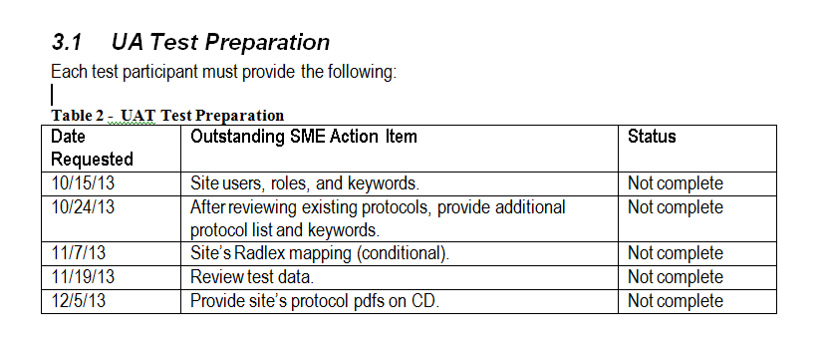
Outstanding SME Action Items

Slide 9
RAPTOR account creation
Name & VA email address
Role(s) – in example: administrator, scheduler, technologist, radiologist, resident
Group(s) – in example: RAD, NM,
Modalities – in example, CT, NM, MR
Keywords – in example: Chest, Head, MSK, Nuclear, Thorax

Slide 10
Milestone #2 Documents
Data Functions
Coding Standards
User Management Tech Guide
Protocol Library
Charts
Hardware Configuration
RAPTOR-VIX Interface
UAT Plan
UAT Cases
PM Plan, v. 1.4

Slide 11
Scheduled Milestones
December 2013 – Theme and Worklist
March 2014 – Templates, RAPTOR connected to database
June 2014 – Additional screen & refinements from user feedback
September 2014 – Site ready for staging
November 2014 – Final UAT
December 2014 – Deployment & Assess next steps

Slide 12
Risk #1: Innovation Sandbox data quality
Date Initially Logged: October 14, 2013
Type: Project functionality
Issue: The data in the sandbox is non-optimal
Mitigation: SAN has spent much resources creating and populating advanced imaging test data and installed the data loader into the sandbox. Image data will also have to loaded.
High impact to UAT and development

Slide 13
Risk #2: Timely feedback
Date Initially Logged: October 14, 2013
Type: Project functionality & architecture
Issue: Gaining timely functional feedback on project deliverables may be a challenge due to clinical priorities. Gaining timely technical feedback is critical for architecture.
Mitigation: Assist and support Innovator with flexible after hours meetings, timely deliverables. The project team will collaborate with additional stakeholders. Lack of administrative support has resulted in outstanding action items not being addressed by users.
Impact: Medium to development and UAT

Slide 14
Risk #3: MS OS and database
Date Initially Logged: October 14, 2013
Type: Project technology
Issue: The PWS specifies Microsoft OS and database (MS SQL Server 2008). The development team recommends change to PWS to use an updated OS such as the open source LAMP stack instead.
Mitigation: After discussions with all stakeholders, SAN agreed to implement MS SQL Server 2008 in SDC servers. Confirm version of VA workstation browser is IE9 and is running on Windows 7.
Impact: High to architecture regarding technical platform

Slide 15
Risk #4: DICOM Image Viewer & Integration Design
Date Initially Logged: October 14, 2013
Type: Project technology
Issue: No obvious choice between commercial and open source DICOM image viewer is currently available
Mitigation: SAN evaluated multiple options during design and determined HTML5 viewer and VistA Imaging eXchange (VIX) most beneficial route to an integrated solution
Impact: Mid to architecture & schedule

Slide 16
Risk #5: Data Storage
Date Initially Logged: October 14, 2013
Type: Architecture
Issue: Project would benefit from storing updates back into VistA
Mitigation: SAN is developing local storage solution. VistA write back enhancement requested
High Impact for Class I requirements

Slide 17
Risk #6: Radiation Dose Reporting
Type: Project technology
Date Initially Logged: October 14, 2013
Issue: Capturing radiation dosage directly from modality is preferred but may be impacted by lack of connectivity or API
Mitigation: Provide alternate data entry mechanisms for radiation dosage. Proposed long term solution as enhancement.
Impact: High to architecture and UAT

Slide 18
Risk #7: Contraindication Maintenance
Date Initially Logged: October 14, 2013
Type: Application Maintenance
Issue: Contraindication factors evolve as knowledge, tools, and medications change; contraindication rules may become out of date if not maintained
Mitigation: Train site administrators on contraindication maintenance
Impact: Low

Slide 19
Risk #7: Contraindication Maintenance
Date Initially Logged: October 14, 2013
Type: Application Maintenance
Issue: Contraindication factors evolve as knowledge, tools, and medications change; contraindication rules may become out of date if not maintained
Mitigation: Train site administrators on contraindication maintenance
Impact: Low

Slide 20
Risk #8: Innovation Project Management
Date Initially Logged: November 7, 2013
Type: Financial, Administrative, Management
Issue: Throughout the project, there has been a lack of communications and leadership by VA Innovations Project Management in providing guidance, approving invoices, provide timely feedback and support, and responding to the project risks. This has jeopardized the project.
Mitigation: Involve contracting and senior management
Impact: HIGH

Slide 21
Risk #9: Production Support of VA Software
Date Initially Logged: December 28, 2013
Type: Production
Issue: Lack of production support and knowledge of MDWS, VIX and CVIX. Closest MDWS and CVIX installations are reportedly thousands of miles away from Sacramento CA.
Mitigation: RAPTOR servers will have to have CVIX installed. SAN has been coordinating with VA on obtaining recent patches and installers to avoid code conflict and keep good configuration management.
Impact: High to schedule

Slide 22
Risk #10: Loss of Palo Alto as a UAT site
Date Initially Logged: January 21, 2014
Type: Production
Issue: Palo Alto, CA (the largest UAT site), has dropped out of the project. Losing the largest site puts pressure on the entire project management staff to find an alternative. The previous 4 months of meetings, action items, etc. has to be repeated to “get-up-to speed” alternative site(s). The loss of the largest site has jeopardized the project. The request for additional resources to “get-up-to speed” alternative site(s) was turned down and contracts sent a “no cost”mod.
Mitigation: By turning down the request for additional funding, the VA has assumed all responsibility to get new site “up to speed”.
Impact: Mid for UAT

Slide 23
Risk #11: Request for VistA Imaging Patch 138
Date Initially Logged: March 11, 2014
Type: Schedule
Issue: Developers are not able to get VIX Patch 138 “in-flight” despite numerous stakeholder meetings and agreements
Mitigation: SAN will continue to make numerous requests for code & installers
Impact: Mid for UAT

Slide 24

Questions

Slide 25
Production Hardware
SAN provided HW specs for verification
Open Issues Include
1. Confirm version of VA workstation browser is IE9 and is running on Windows 7
2. Schedule monthly touch point meetings between the RAPTOR Team and RO1 OIT PM
3. Jacqui to write up RO1 Data Center Requirements
4. Provide information requested by development team on data center procedures, backup, etc.
5. VA will support all of the Data Center installation. SAN will not be admitted to the data center hence no travel to Sacramento is required. How will communication be facilitated?
6. Does production support and knowledge include Imaging Architecture (VIX)?
8. The PWS doesn’t mention switch. Is the expectation that SAN should include this?
9. Clarify PWS requirement - are both fiber or Ethernet channels required?

Slide 26
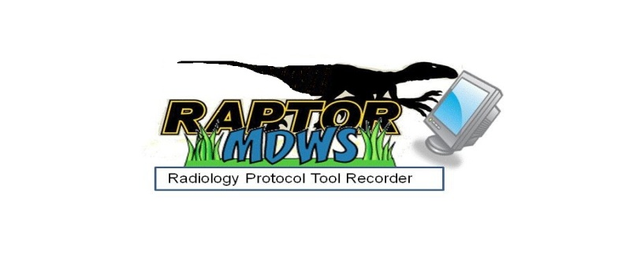
Logical Architecture
Content Management System
Web Server
Data Adapters
RAPTOR users interact through an open source web based radiology dashboard that contain expert decision support logic. Through web services, the electronic health record data is instantly available.
VIX
MDWS
VistA Data
Local DBMS
Images

Slide 27
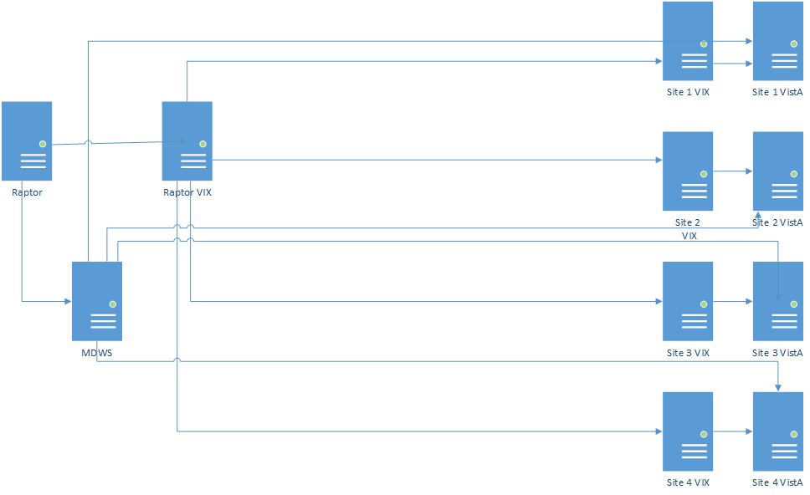
Physical Architecture
Sacramento Data Center

Slide 28
Worklist Page Demo
Worklist Columns can be hidden
Additional (Modality, Scheduled) & rearranged columns
Rows are managed to minimize scrolling
Adding Schedule info
Sorting

Slide 29
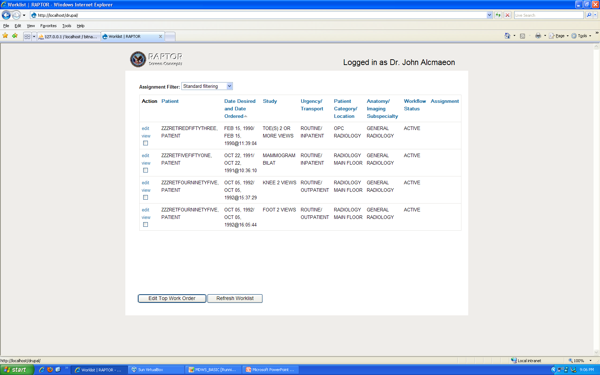
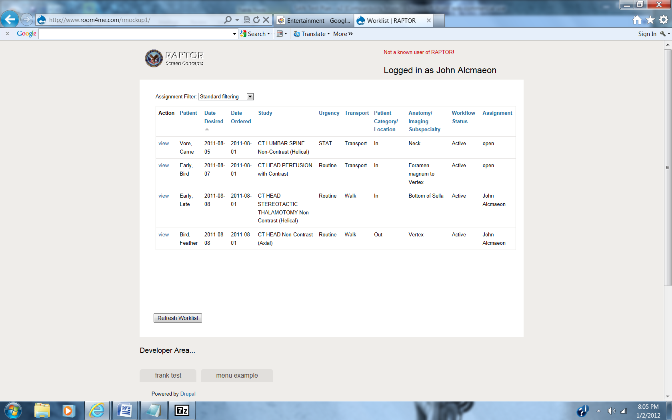
POC Concept

Slide 30
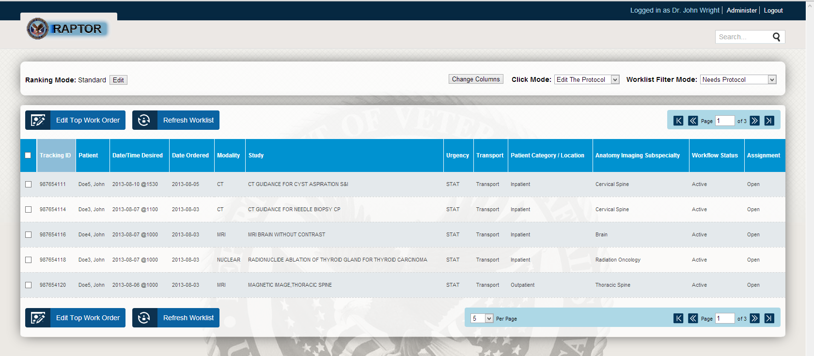

Slide 31
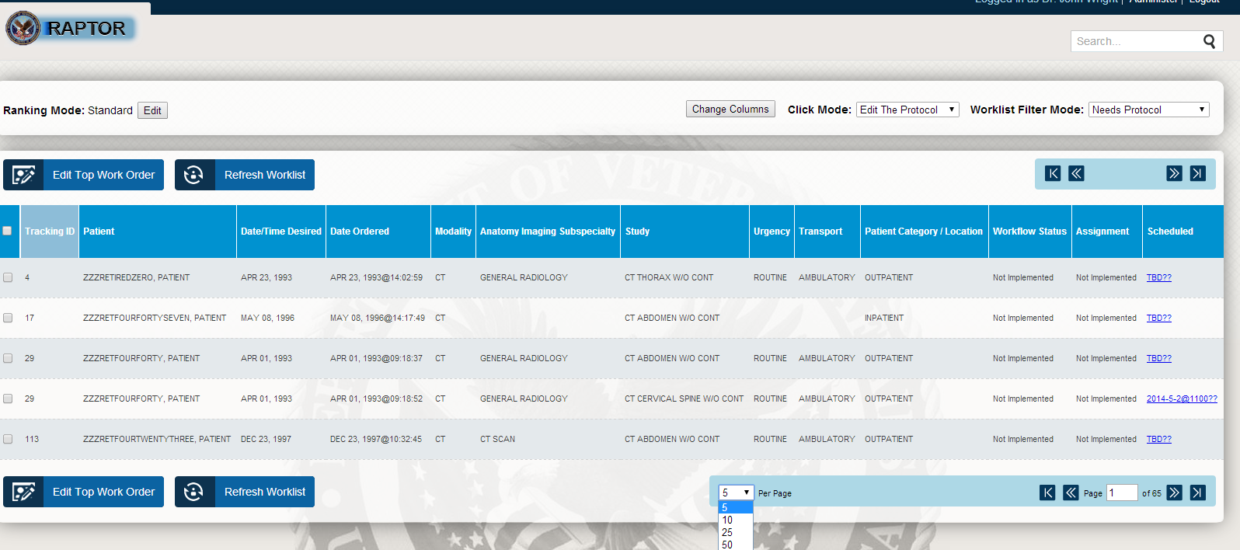

Slide 32
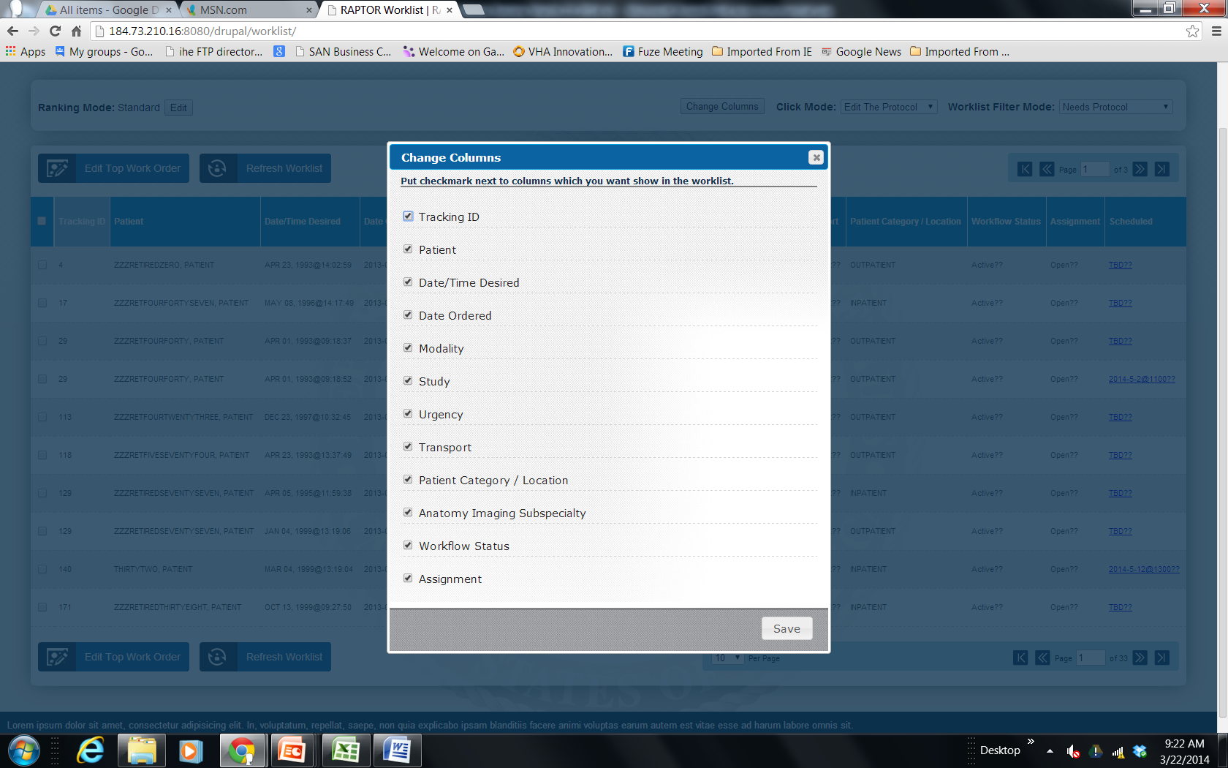

Slide 33
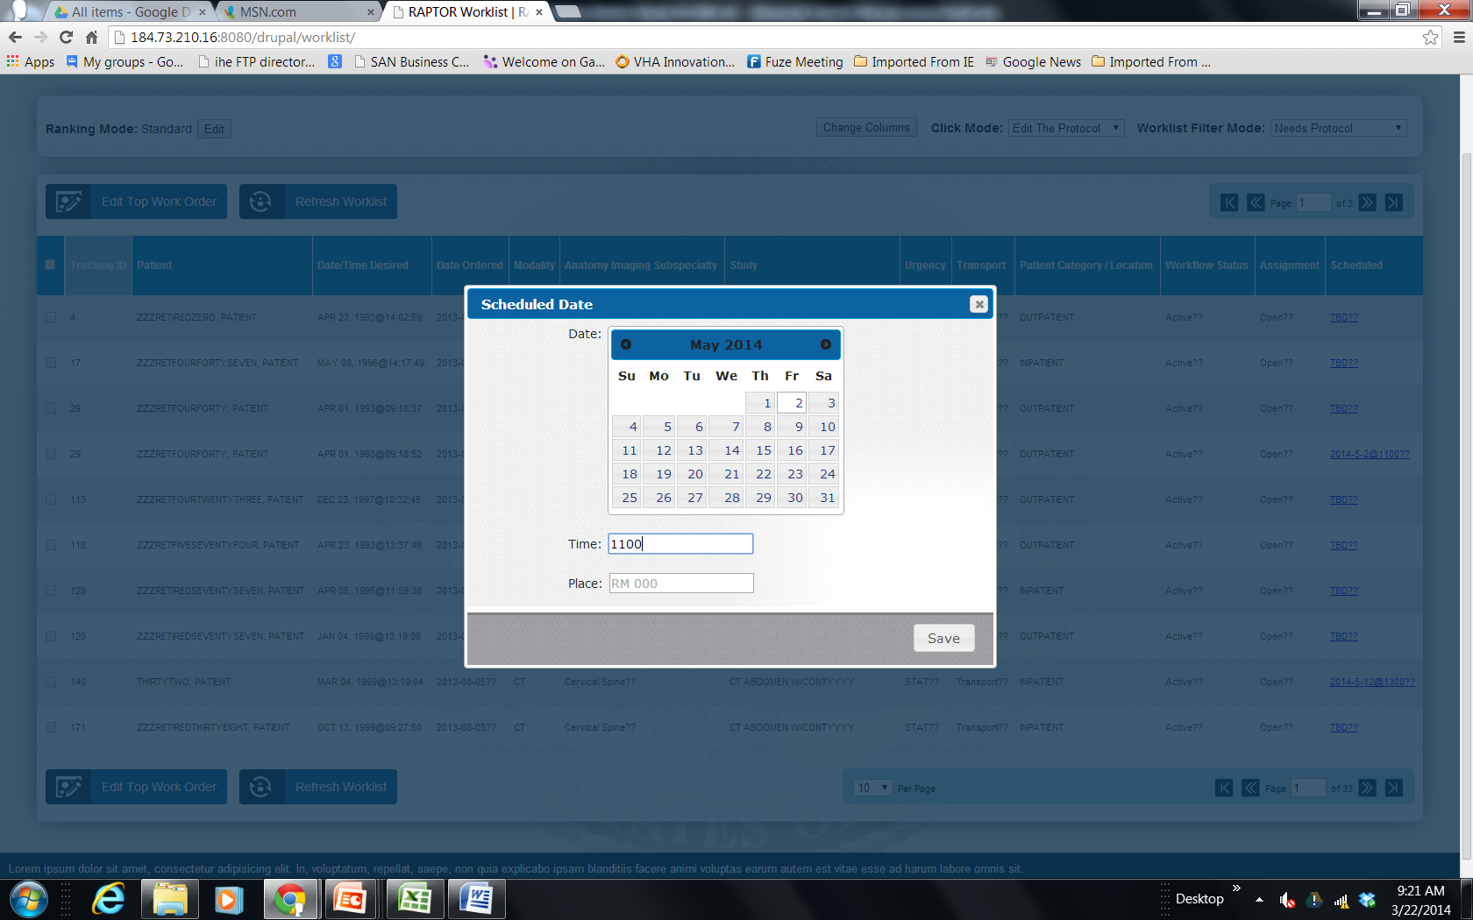

Slide 34
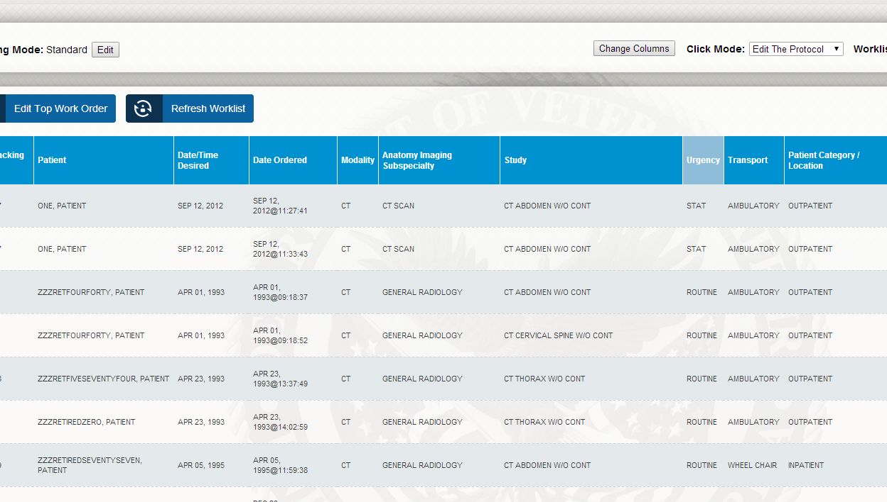
Sorting on Urgency

Slide 35
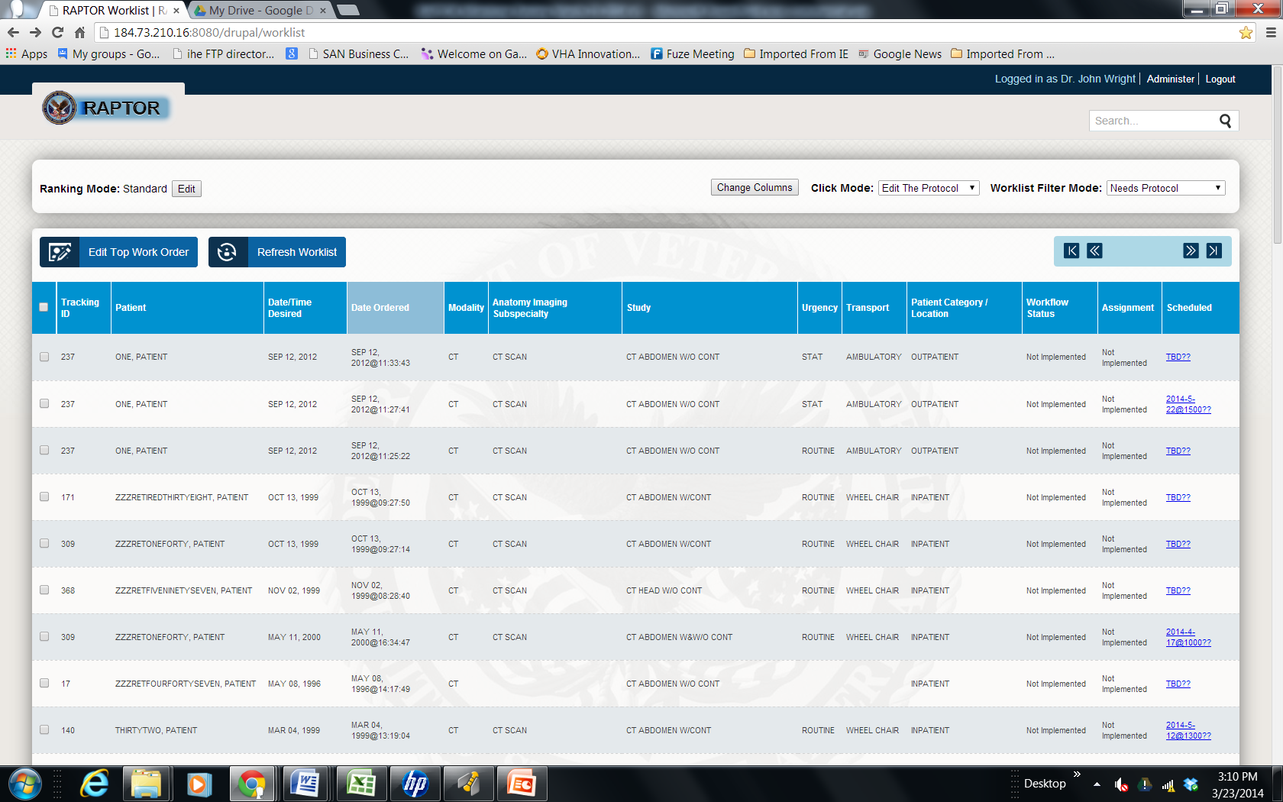
Sort on Date

Slide 36
Dashboard Page
Templates Concept
Auto-populate fields
Contraindication details
Suspend/ Reserve

Slide 37
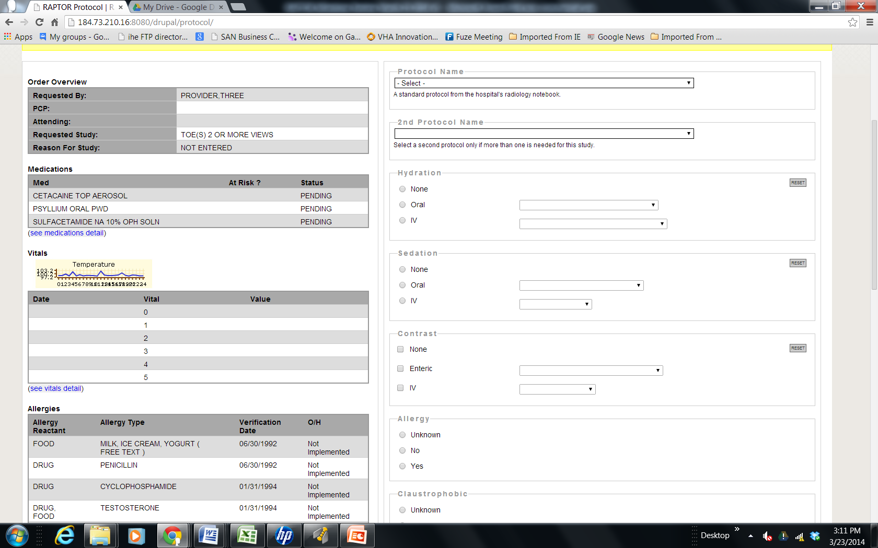
Template Concept

Slide 38
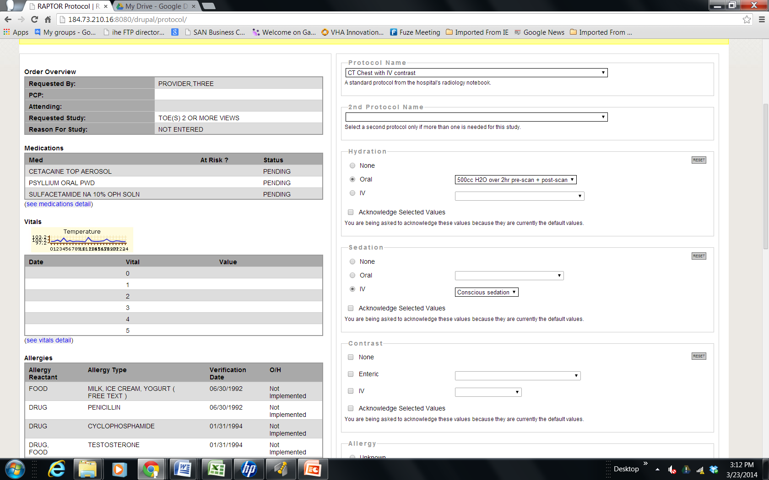
Auto-populate fields

Slide 39
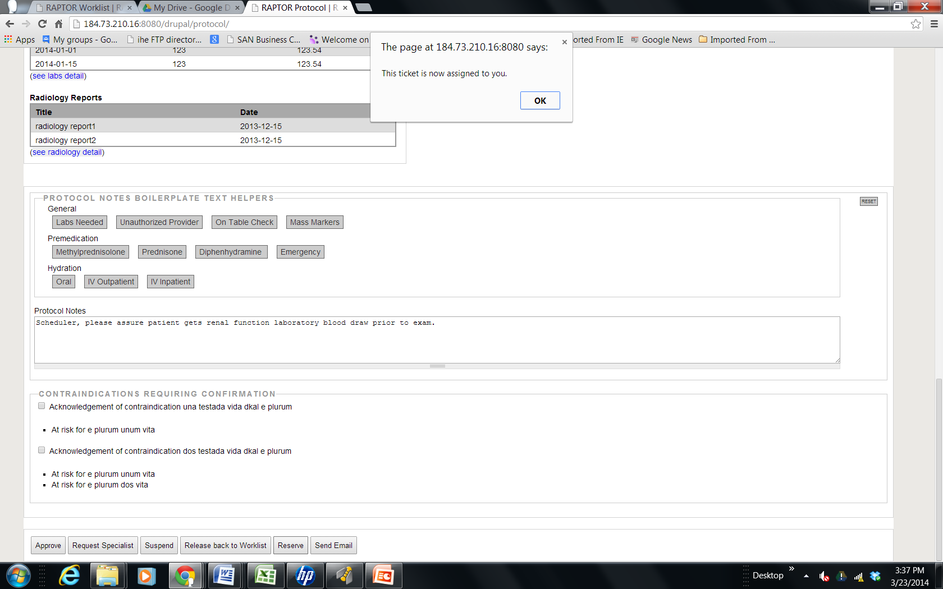
Reserve

Slide 40
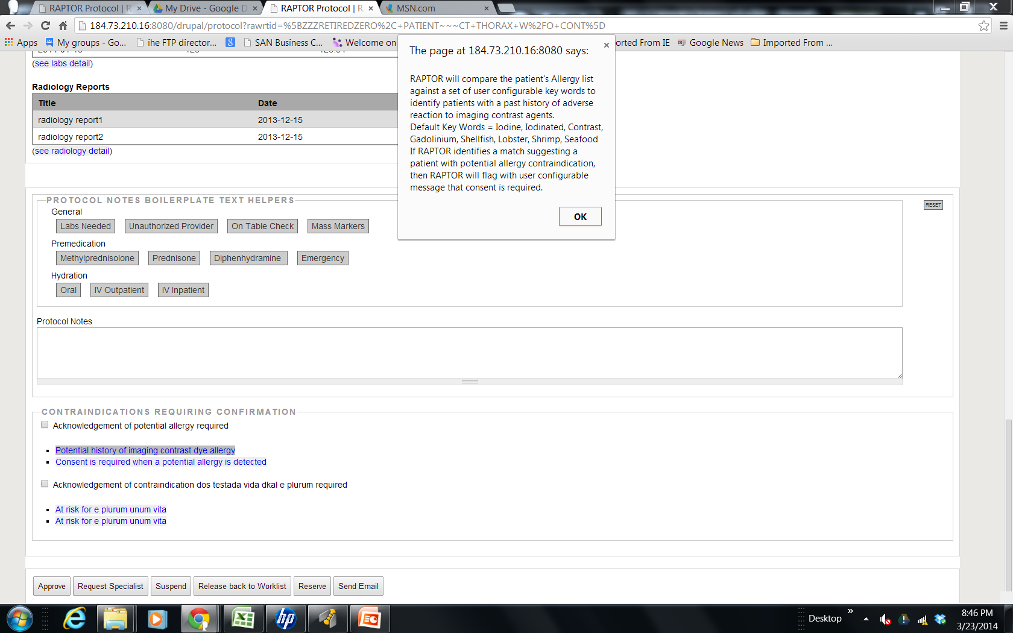
Contraindications Drill Down

Slide 41
More info
www.sanbusinessconsultants.com
JDI, Medverd, January 2013
SIIM 2012 Conference: Top 5 Medical Imaging IT Projects of 2012
RSNA 2012
Drupal in Government 2012
OSEHRA 2013

